Slide 1
Natural Gas Emissions from the Heavy and Medium Duty Trucking Sectors Quantifying methane emissions at fueling and maintenance facilities
Nigel Clark, Principal Investigator
Nigel.Clark@mail.wvu.edu, 304 293-4813
W. Scott Wayne, David McKain, Hailin Li, Daniel Carder
Co-Principal Investigators
Center for Alternative Fuels, Engines and Emissions
West Virginia University
Morgantown, WV USA
August 21, 2012

Slide 2
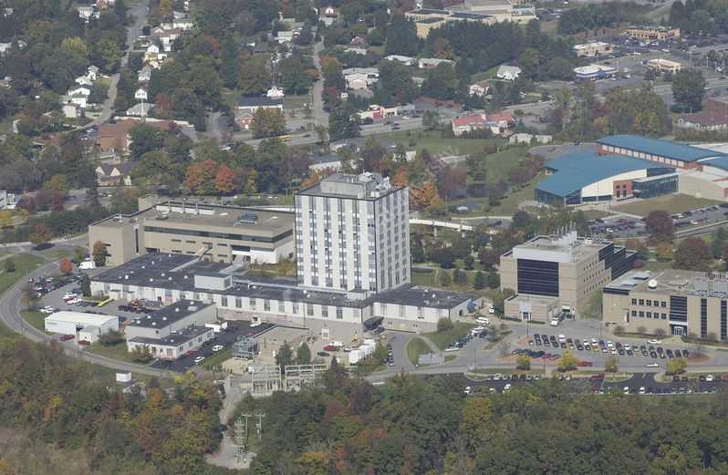
Center for Alternative Fuels, Engines and Emissions: CAFEE
West Virginia University Land Grant Institution with Strong Applied Research Record
Benjamin M. Statler College of Engineering and Mineral Resources
Department of Mechanical and Aerospace Engineering
Center for Alternative Fuels, Engines and Emissions (CAFEE)

Slide 3
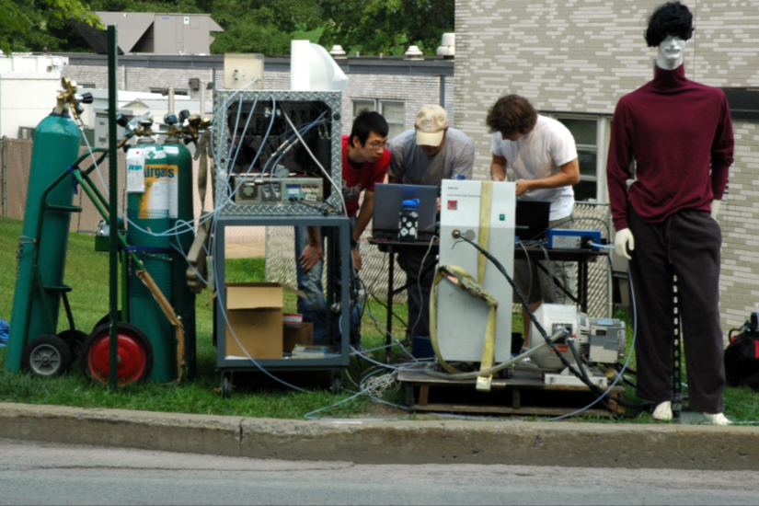
CAFEE: Research Experience
Over $70 million in funded research over the past two decades
Research Areas
Tailpipe Emissions
Exhaust Plume Characterization
Dual Fuel Engine Research
Engine/Vehicle Driving Cycle Development
Emissions Modeling
Vehicle Activity Studies
Engine Design
Fuels Evaluation
Life-Cycle Cost Modeling

Slide 4
Fugitive Methane Emissions
Fugitive Sources: Fueling and Maintenance
Unintentional
Leaks
Continuous
Intermittent
Failure
Poor Assembly
Refueling
Disaster
Intentional
LNG boil-off
Pressure relief
Discharge

Slide 5
Relevant Emissions Levels
Natural gas methane emissions are considered
At higher level of loss economic impact becomes important
Carbon dioxide emissions from natural gas trucks are 0-25% lower than from conventional diesel trucks
We have selected a 5% carbon dioxide equivalent impact as a criterion
We have assumed, simplistically, that methane is equivalent to 20x carbon dioxide by mass
5

Slide 6
Fueling Station Loss Impact Analysis
Based on methane being equivalent to 20x carbon dioxide by mass, a 0.4% discharge methane has the same GHG impact as a 5% increase in carbon dioxide emissions
Consider a fueling facility that dispenses 1000 kilograms per day of natural gas
0.4% loss represents (assuming 100% methane)
4 kilograms (5,600 liters, 198 cubic feet) per day
2.8 grams (3.8 liters, 0.137 cubic feet) per minute
0.047 grams per second (0.063 liters, 0.0022 cubic feet) per second
We therefore need to be able to quantify this level of loss with reasonable accuracy
6

Slide 7
Methods for Quantification
Component Based
Identify all leaks/discharges, whether continuous or intermittent
Quantify the leaks/discharges through enclosure/hi-volume sampling
Determine frequencies of intermittent discharges
Sum the quantities to determine daily loss rate
Station Based
Tent/Enclose entire facility and determine loss by measuring concentration and through-flow
Suitable for small facilities
Atmospheric Based
Use atmospheric sampling techniques to estimate loss
Station inventory (mass balance)
Measure difference between fuel supplied to station and fuel delivered to vehicles
Relies on ability to measure natural gas accurately
NG fueling industry using micro motion flow meters: +/- 0.5% of fuel delivered
7

Slide 8
Methane Quantification: High Volume Sampler
Variable Speed Blower
Sample (Air + Methane)
Flow Measurement V_{sample}
Mixing Orifice
Methane Analyzer (X_{methane})
Methane Calculation
V_{methane} = X_{methane} * V_{sample} – V_{methane_bkgd}
Flow measurement accuracy
Analyzer accuracy
V_{methane_bkgd} typically 1.5-3 CF per 1,000 MCF
Methane concentration of 13,700 ppm given
0.137 CFM methane leak (0.4% or 198 CF)
10 CFM sample flow

Slide 9
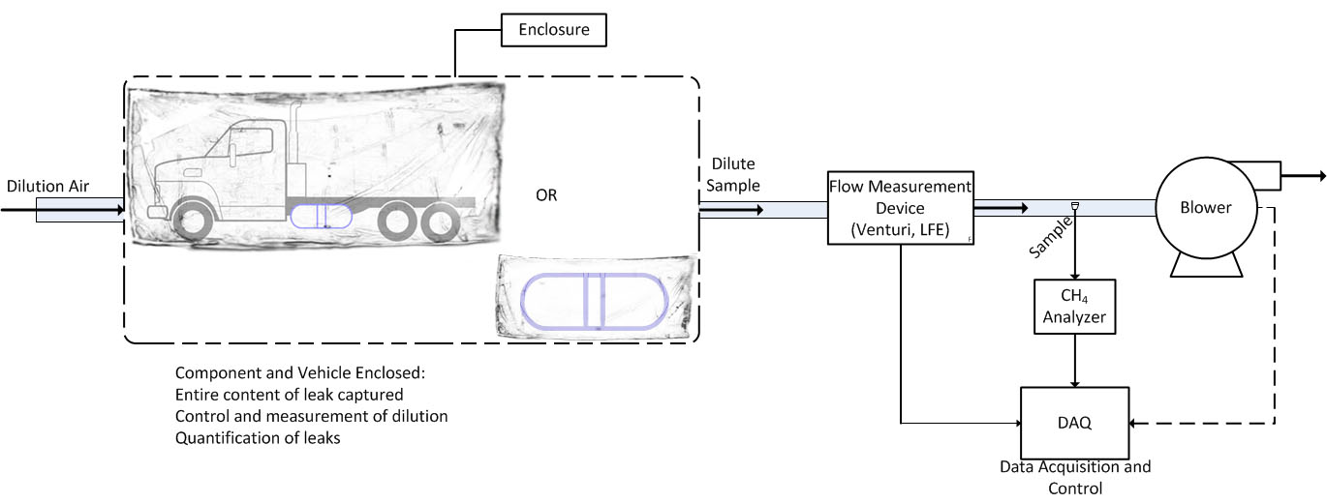
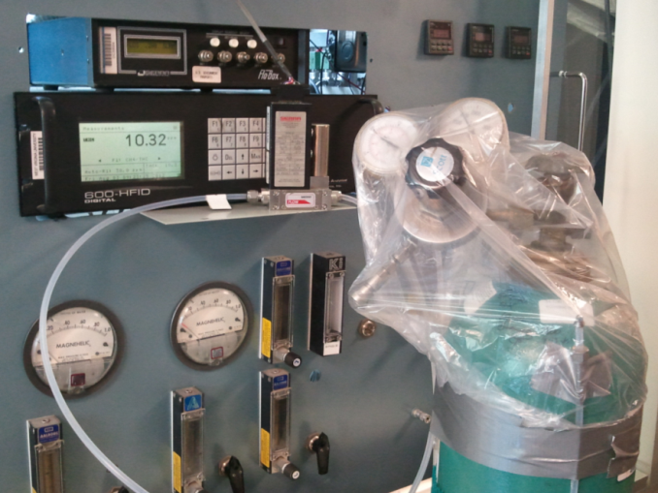
Methane Quantification: Enclosure Methods
Enclosure placed around component (tank, valve, vehicle, pump, station)
Ambient background air drawn through enclosure at controlled/measured rate
Methane concentration of sample measured

Slide 10
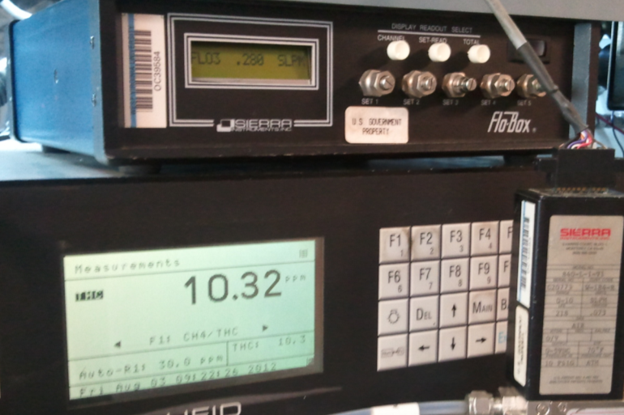
Methane Quantification: Enclosure Methods
Enclosure (bag) around potential leak site
Sample mass flow measured
Methane analyzer used to measure sample concentration
Methane leak example:
Sample flow = 0.28 l/min
Sample methane concentration = 10.32 ppm
Background methane concentration = 2.93 ppm
Leak Rate = 1.47 grams per minute
Sample Methane Concentration and Flow

Slide 11
Basic Atmospheric Sampling Analysis
Assumptions
30 foot high by 300 foot wide sample planes (9,000 square feet)
Sample planes located 300 feet upstream and 300 feet downstream from leak site
Methane leak rate of 0.137 CFM
Wind speed of 5 mph (440 feet per minute) perpendicular to sample planes
Volume flow through samples planes is 3,960 MCF per minute (9,000 ft² x 440 ft per minute)
Upstream plane is at background concentration (1.5-3 ppm)
Average methane concentration in downstream plane is increased 0.034 ppm (2.3% to 1.1%)

Slide 12
Atmospheric Methods
Measure upwind and downwind methane concentrations
Mass fluxes quantification
Volume flux
Micrometeorological models
Tracer gas
Methane Concentrations
Point source(s) sampling
Line (plane) detection
Sniffer or high-volume sampling required for identification/quantification of individual sources
Wind speed/direction requirements
Loss levels of interest may still yield low concentrations
12

Slide 13
Quantification by Mass/Volume Metering
Masses or volumes of fuel supplied to and delivered by facility compared
Measurement accuracy:
Mico-motion metering accuracy: +/- 0.5%
Utility meter accuracy: -2%-+1%
Accuracies are at or above the loss of interest (0.4%)
Methane content of fuel is not known
Peak shaving gases in some regions may be very low in methane
13

Slide 14
Fueling and Maintenance Surveys
Responses to verbal interviews, questionnaires and inventories with respect to fueling and maintenance procedures
Fueling facility practices
Vehicles fueled
Fuel quantities delivered
Fueling frequencies
Fueling equipment, procedures and storage
Fleet inventory with engine/fuel system information
Natural gas released during vehicle maintenance
Vehicle storage practices
Use of recovery equipment

Slide 15
Methane Inventory Model
Predictive spreadsheet model
Estimates of nationwide contribution from heavy-duty transportation sector
Default values included
Fleet population
Fueling station population
Activity and event frequencies
Emissions data
User values for improved estimates
Outputs
Mass per year
Nationwide mass per year
Mass per vehicle per year
Mass per vehicle mile travelled

Slide 16
Facility Measurements
Preliminary evaluations
Two fueling stations, one CNG and one LNG
“Bottom up” approach (high-volume sampling) and upwind/downwind
Results presented to TAP before proceeding
Detailed evaluations
Four refueling stations and two maintenance facilities
Leak detection and quantification
High-volume/enclosure measurements of each leak
Quantification of intermittent leaks (eg. refueling)
Vehicle tailpipe methane emissions screening
Standard evaluations
Four refueling stations and two maintenance facilities
Leak detection and quantification with high-volume sampling
16

Slide 17
Procedures for Facility Emissions
Initial Site Visit
Survey and document/inventory site
Develop test plan
Confirm test plan with technical advisory panel and steering committee
Site Evaluation
Transport personnel and equipment to site
Calibrate/verify test equipment
Interview operational personnel
Perform facility methane emission detection
Perform facility methane emission quantification
Refueling/Maintenance methane emissions quantification
Review and archive data
17

